Slide 1
Hindi handwriting recognition using DNN

Slide 2
Abstract
Hindi Handwriting Recognition is ability of Machine to take handwritten documents, photos as input and interpret the character in digital/ machine language form. The input is generally of image form, that is fed into pattern-recognition system. Handwritten Character Recognition plays an important role and is currently getting the attention of researchers because of possible applications in assisting technology for blind and visually impaired users, human–robot interaction, automatic data entry for business documents, etc. In this work, usage of different Deep Learning Techniques are implemented. In this work, I will be using different model Architecture, such as Convolution Neural Network, LeNet-5 and some transfer learning models. The optimizer used is RMSProp and Adam. The dataset consist of 92000 images of characters taken from Kaggle Dataset.

Slide 3
Literature review
Some of the papers have used various models to get accuracy over 95%.
The papers have not included augmenting the dataset to provide more variation to the training data.
Almost all the papers have mentioned using RMSProp and Adam as optimizers.
Both the used optimizers have given a good result in providing great accuracies over the dataset.

Slide 4
Existing methods
Merits
Some of the Methods have included classifying the input data into offline and online handwriting recognition, separating them from each other.
A variety of methods have been used such as OCR, SVM, DNN, DFFNN, CNN to include the few.
There have been models that requires a lot of computation also been included which have given accurate results.
Demerits
Some of the paper however have failed to include a large datasets which could have resulted in overfitting of the data giving false accuracy.
Almost all of the existing systems have not used data augmentation to increase the variation of the input since the input provided does not vary a lot with shear range, rotation range, width shift range and others such manipulation.

Slide 5
Challenges
Some of the models to be used requires a lot of computation. These models can only be applied using good accelerated hardware(large RAM).
The input data provided consist of inverted images. So the testing process for the model requires the image to first be converted to an inverted image and then be used for testing.
Hindi letters are absent in ASCII code, so it is hard to map and display the given Hindi letters to the classes used for classification.

Slide 6
Problem statement & objectives
Nowadays, everything has become virtually available. There has been rise of pdf to word conversion of physical documents. There is a need for hindi character conversion as well. Hindi Documents are used in many states, businesses and government.
It can help build the bridge between spoken hindi and written hindi.
The project will create a foundation for handwritten document translation. The translated document can directly be used through devices such as phones, laptops.
The further scope of this project can enable direct editing of offline document.
The conversion of handwritten document to online document can be established.
It can help visually impaired people to understand spoken hindi characters through written documents.

Slide 7
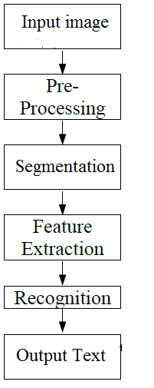
Block diagram

Slide 8
Module description
Inputting the Data
Cleaning the data
Splitting the data into train and validation set
Visualizing the data
Data Augmentation
Creating the Model
Feature Extraction
Recognition
Output Text

Slide 9
implementation
Have successfully taken the input from Kaggle Dataset as csv file.
Cleaned and Labelled the data.
Randomized the dataset.
Split the data into train and validation in 8:2 ratio.
Visualized the first 10 images.

Slide 10
Questions?

Slide 11
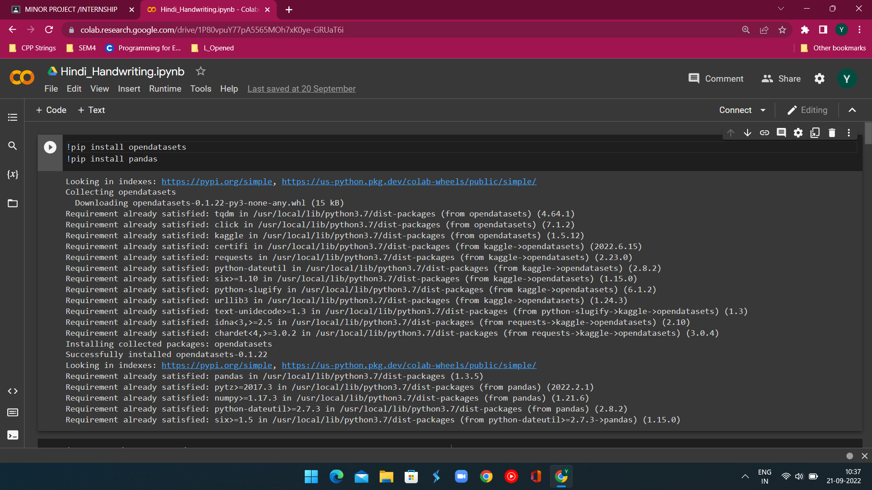
Importing Libraries

Slide 12
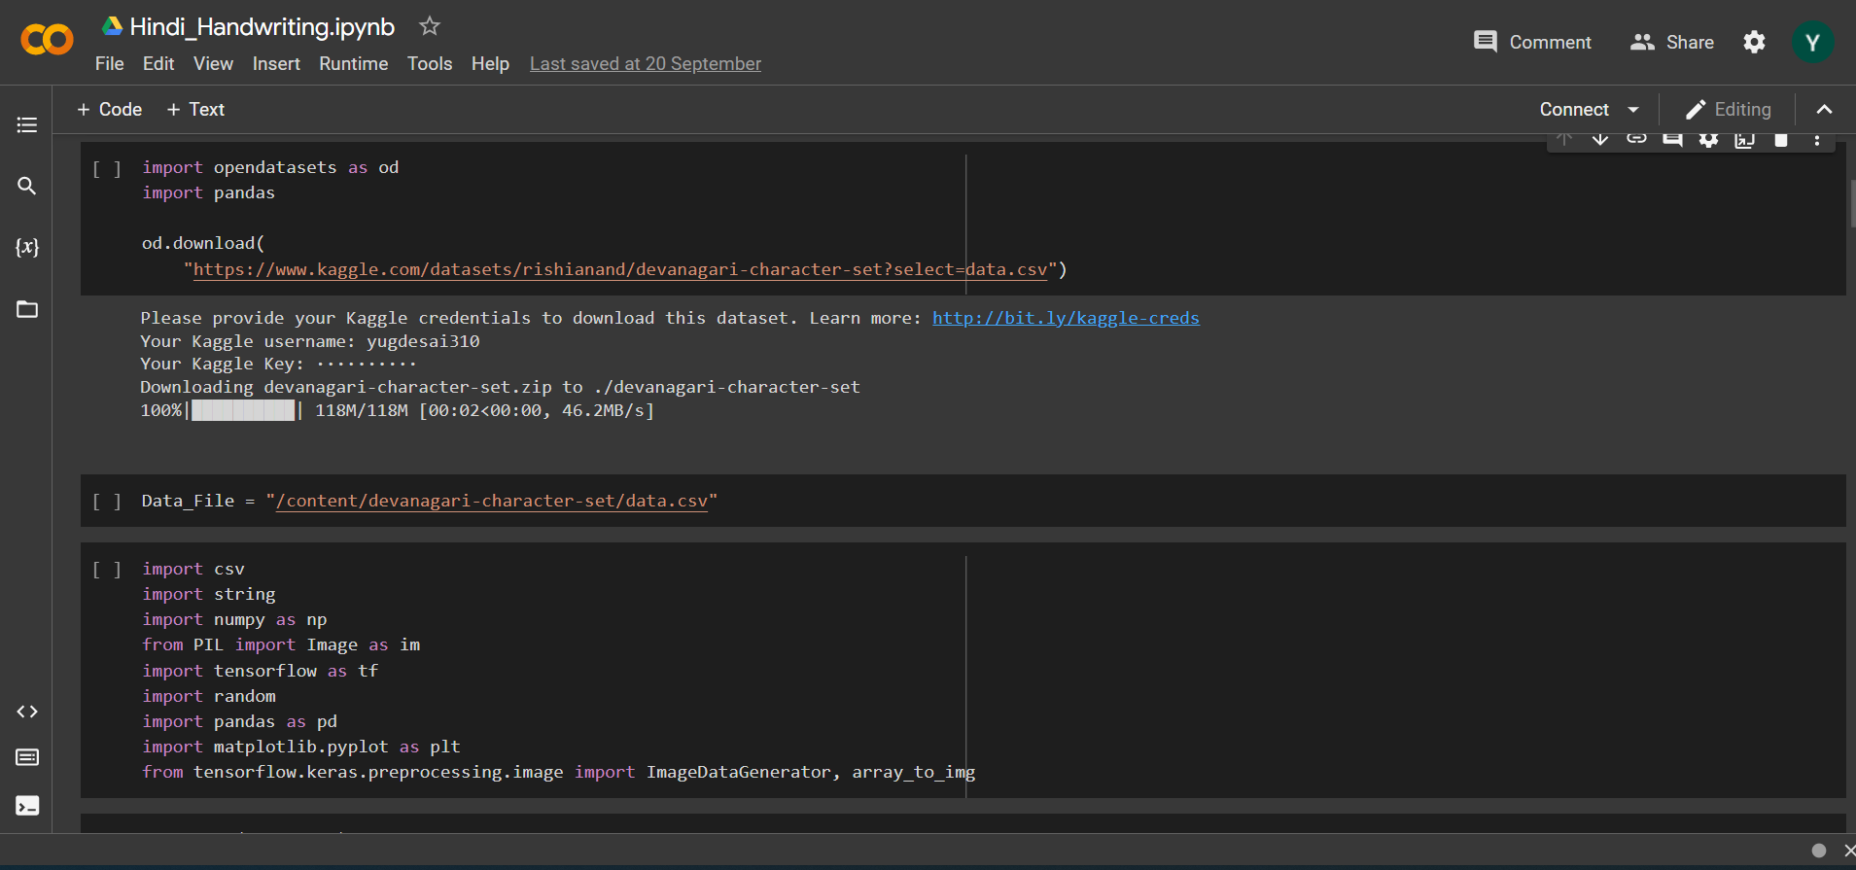
Importing Dataset

Slide 13
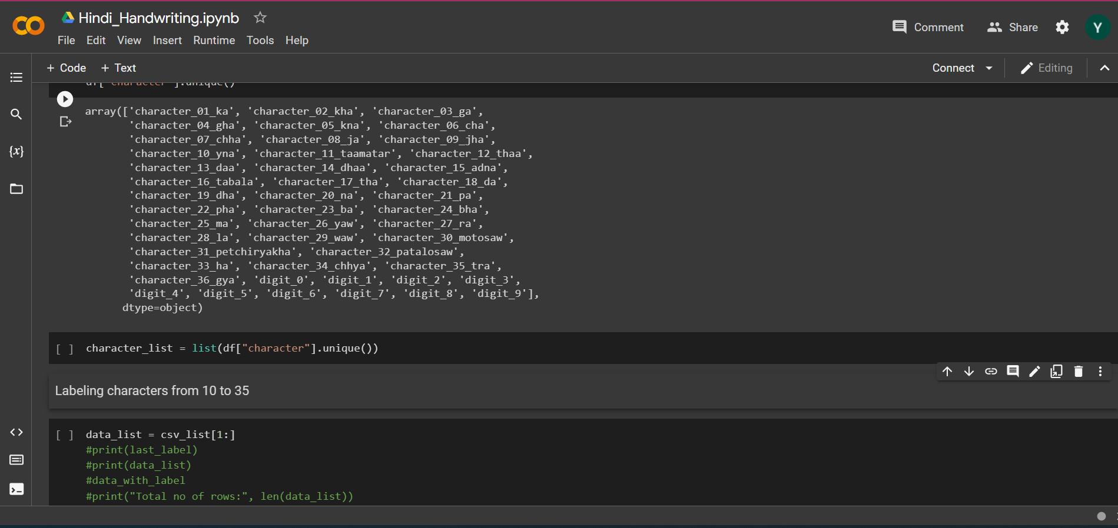
Data Cleaning

Slide 14
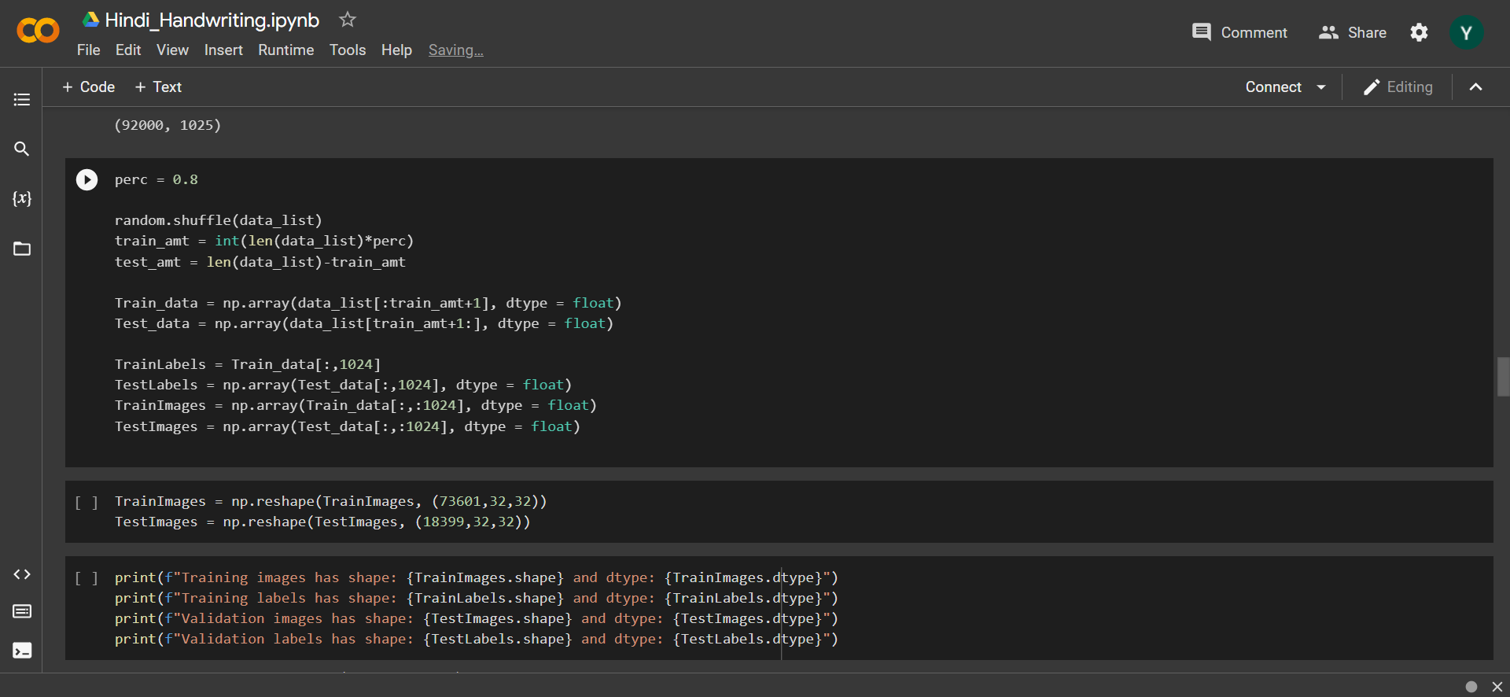

Split Size

Slide 15
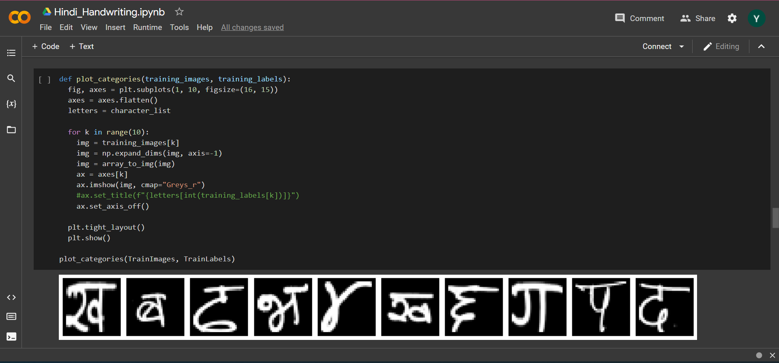
Data Visualization

Slide 16
References
https://www.researchgate.net/publication/332114646_Handwritten_Hindi_Character_Recognition_using_Deep_Learning_Techniques
https://ieeexplore.ieee.org/document/8991403
https://www.sciencedirect.com/science/article/pii/S1877050915003737
https://arxiv.org/abs/2008.12995
https://www.coursera.org/professional-certificates/tensorflow-in-practice?#courses

Slide 17
THANK YOU
Mirjam Nilsson​
mirjam@contoso.com
www.contoso.com

